Slide 1

Service Management Automation (SMA) Suite Technical Presentation Training, Level 320 Module 3: Competition
Carol Hibbard
You can:
Download the presentation.
Download PowerPoint slides & speaker notes.
October 2018
Notes:
[STANDARD SLIDE: L300 (animated)]
You can change out the photo with any image from Getty Images in DropBox.
The module number is listed in the title and explicit instructions for downloading the PPT are mentioned in the notes.
You may have to adjust the title font size or increase the size of the text box to make things fit.
You may have to move the title text around depending on the photo. Make sure the text is readable against the background photo.
You can change the background color for the rectangle in the bottom-right corner to look better against the background. Choose a Micro Focus color at 25% transparency.
=========================
Note to Narrator or Reader: [PRESS] indicates press the Page Down key to show the animation
=========================
Hello and Welcome to Module X of [COURSE_NAME] Technical Overview Training, Level 300.
[If this is the first module, mention: “There are X modules in this course that explore detailed technical information about PRODUCT_NAME”]
In this course you’ll gain a high-level understanding of the essentials of [PRODUCT_NAME].
[PRESS] If you want to download this presentation and save it on your own system, click the Tools & Help icon in the bottom-right corner of your window and select Download.
Or, if you want to access the PPT slides and speaker notes for future reference, go to the Attachments tab in your window and click to download the presentation. This is very useful when you later prepare for the comprehensive Certification Exam.

Slide 2
Understand competitors and how to win
Analyst assessment of Strengths and Weaknesses for Micro Focus and Competitors
SMA Differentiators
Traps to set for our competitors
Traps they will set and our responses
Strategies to win

Slide 3



SMA Competition
What they say about themselves
Replace unstructured work patterns of the past with intelligent workflows of the future. Improve service levels, energize employees, and change the way your enterprise works.
Comprehensive ITIL support with world-class self-service portal.
Codeless design for easy customization and hassle-free upgrades.
Choose from subscription or perpetual concurrent licensing, on-premise or SaaS.
Accelerators of Digital Enterprise Management
Gartner Magic Quadrant Leader again
BMC digital IT powers 82% of the Fortune 500 companies

Slide 4
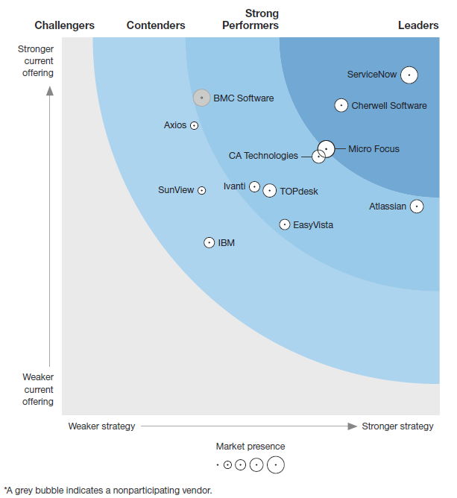
The Forrester Wave™: Enterprise Service Management, Q3 2018
Vendor | Current Offering | Strategy
ServiceNow | 4.50 | 4.60
Cherwell | 4.10 | 3.70
BMC | 4.20 | 1.85
Micro Focus | 3.52 | 3.50
Among the 3 leaders Micro Focus scored highest for:
Core service management
Information Management and Analytics

Slide 5
Micro Focus SMAX 2018.05 Assessment from Forrester
The Forrester Wave: Enterprise Service Management, Q3 2018
Pro
Strong advanced analytics capabilities applied to ESM use cases such as ticket auto-categorization.
Best-in-class change management, including advanced risk analytics and optimization of the change process itself — crucial in the age of DevOps.
Strong CMDB discovery capability, including Kubernetes and container-based deployment.
Con
Higher skill requirements than those of other vendors.
Investment
Frequent releases to rapidly iterate and improve offering.
Limited business-oriented capabilities (HR module) and has now added an effort to develop a service app store to its roadmap.

Slide 6
ServiceNow Kingston Assessment from Forrester
The Forrester Wave: Enterprise Service Management, Q3 2018
Pro
Deep ITSM capabilities in asset and configuration management.
Variety of business service modules, such as HR and facilities.
One of the market’s most powerful PaaS environments, robust enough to be featured in Forrester’s research on general-purpose low/nocode platforms.
Con
The platform may be more “low” than “no” code, as customers noted that they needed skilled developers to achieve success.
Complex licensing and pricing models.
Consistently high cost.
Investment
Prioritizing ongoing UX improvements (including in the development environment and through a new mobile experience)
Platform investments in a native virtual agent and machine learning functionality.

Slide 7
Cherwell 9.3.2 Assessment from Forrester
The Forrester Wave: Enterprise Service Management, Q3 2018
Pro
One of the most capable low/no-code platforms for service and workflow design.
Established ITSM capabilities.
Dedicated PPM; security, facilities, and HR modules.
Strong data governance and compliance functionality.
Con
Lacking in advanced analytics and machine learning, and customers noted issues with its native reporting tool.
Although this vendor has a CMDB, most customers use a third-party tool, Firescope, for discovery.
Investment
Enhancing its UI/UX.
Expand into more business-oriented modules.
Improve collaboration and automation via chatbots.
Automation toolkits.
RPA integration.

Slide 8
BMC Remedy 9.1, 18.05 Assessment from Forrester
The Forrester Wave: Enterprise Service Management, Q3 2018
Pro
One of the best-known names in ITSM.
BMC Software retains a large customer base. Enterprises have long used its flexible Action Request platform to support a variety of service request workloads at scale, such as customer service in large banks.
Coverage of the ITSM core (request, incident, problem, change, and configuration management) is among the strongest in the market.
Con
Customers often cited difficulty in upgrading from earlier versions of Remedy as their primary reason for moving to other solutions.
Uncertainty regarding the long-term company strategy due to recent ownership changes.
Investment
Continues to make steady improvements in its ESM offering, with Helix Business Workflows.
Remedy 9 features upgrades to its low/no-code workflow designer among other ease-of-use enhancements.
Note: BMC Software declined to participate in our research. Scores are based on Forrester estimates and our review of publicly available product documentation.

Slide 9
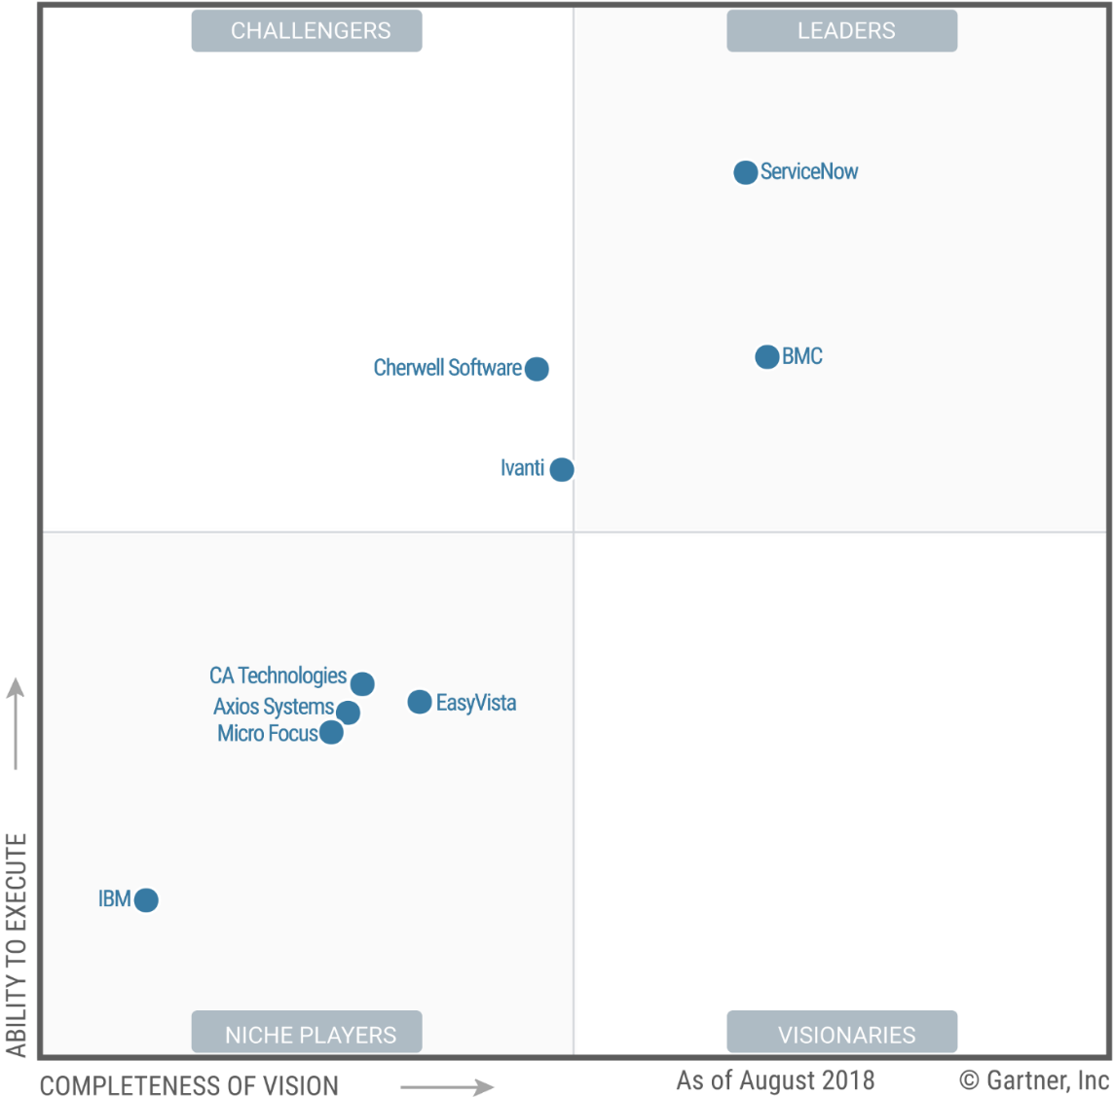
Gartner Magic Quadrant for IT Service Management Tools
Published 16 August 2018 - ID G00340718

Slide 10
Micro Focus Assessment from Gartner
Magic Quadrant for ITSM Tools – August 2018
Strengths
Micro Focus SMA, as well as all of Micro Focus' other ITOM tools, uses the company's Container Deployment Foundation (CDF) as a means to provide deployment options in a number of different environments.
Micro Focus has global reach and a good balance of direct and partner-sourced sales.
Merging legacy Hewlett Packard Enterprise (HPE) and Micro Focus customers results in a larger target customer base that presents growth and cross-selling opportunities.
Cautions
Gartner customers have reported in inquiry that disruptions associated with the divestiture of HPE ITSMA to Micro Focus have left them uncertain about future product directions and the associated risk to their existing product investment.
ITSM tools are a relatively small portion of the overall revenue for Micro Focus, and in comparison to the rest of the organizations appearing in this Magic Quadrant.
Apart from several major ITSM shows and local meetings convened through industry/professional associations, Micro Focus' marketing efforts have primarily been directed toward either internal or HPE-centric audiences.

Slide 11
ServiceNow Assessment from Gartner
Magic Quadrant for ITSM Tools – August 2018
Strengths
ServiceNow’s global reach with local sales and support organizations and strong brand recognition dominates customer shortlists, and its ITSM tool revenue market share is almost triple that of the closest competitor.
ServiceNow has been improving its wider ITOM capabilities over the past few years, through the maturation of earlier acquisitions that complement its ITSM product (such as service dependency mapping for configuration management database [CMDB]).
As a result of ServiceNow's dominant market position, its platform has helped build a strong partner ecosystem including professional services and integrations.
Cautions
Interactions with Gartner clients indicate that some organizations with low I&O maturity struggle to demonstrate sufficient value from their ServiceNow investments and sometimes start with a less-expensive alternatives to meet their needs.
As the majority of ServiceNow transactions today include more than one licensable product/application, many Gartner customers report having difficulty explaining the pricing/licensing models to senior management.
While new, optional features (e.g., incident categorization based upon machine learning) offer the potential for operational cost savings, the shift to usage-based pricing has the potential to increase budgeting risk due to unplanned increases in total annual spend, as feature utilization increases.

Slide 12
Cherwell Assessment from Gartner
Magic Quadrant for ITSM Tools – August 2018
Strengths
Cherwell has continued to drive good customer engagement and attract a loyal following of satisfied customers.
Cherwell maintains a growing set of third-party integrations and community-driven extensions to its platform via its Mergeable Application (mApp) Exchange.
Cherwell has been successful marketing its ITSM platform targeting the needs of intermediate maturity I&O organizations and was second most frequently shortlisted in Gartner inquiries in 2017.
Cautions
Although Cherwell has introduced enhancements and new technology integrations, not enough of its R&D spend has translated into enhanced organic tool capabilities or user experience improvements.
Cherwell’s focus on expanding to other areas of the business outside of ITSM opens it up to the risk of decreased innovation for its core product.
Cherwell has seen strong partner growth in North America and EMEA, but it is essentially flat elsewhere. In some regions, customers have reported difficulty in sourcing implementation partners

Slide 13
BMC Assessment from Gartner
Magic Quadrant for ITSM Tools – August 2018
Strengths
Remedy Service Management Suite's Smart IT user interface and Smart Recorder improve usability and flexibility, and demonstrate BMC's innovation with ITSM tooling ahead of other vendors in this market.
BMC has a broad ITOM portfolio, making it a viable partner for mature I&O organizations that need to extend their ITSM tool.
BMC has the largest enterprise ITSM customer installed base available for ongoing nurturing and upsell opportunities.
Cautions
Market perception of the Remedy brand among Gartner clients continues to be associated with legacy experiences.
Many Gartner customers report that the typical bundling and pricing options require them to spend more to purchase add-ons to get advanced capabilities such as Digital Workplace Advanced.
BMC's tools for addressing the needs of lower-maturity organizations (Remedyforce, Track-It and Footprints) appeared on few Gartner client shortlists during 2017.

Slide 14
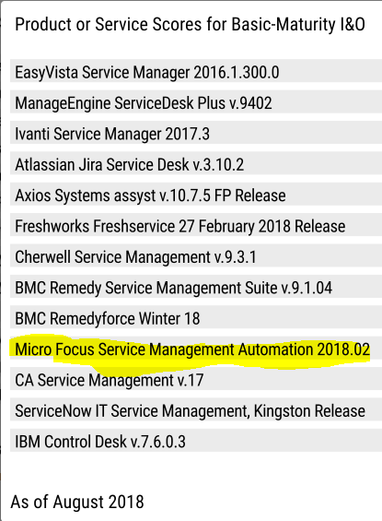
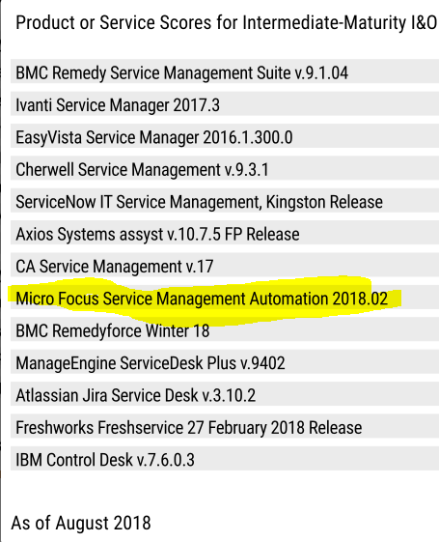
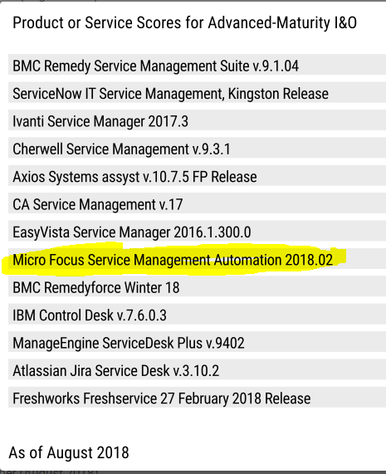
Gartner Critical Capabilities Ranking

Slide 15
Gartner Critical Capabilities for ITSM Tools (August 2018)
Critical Capabilities |  | BMC Remedy Service Management Suite v.9.1.04 | ServiceNow Service Management Suite, Kingston Release | Cherwell Service Management v.9.3.1 | Micro Focus SMAX 2018.02
Incident and Problem Management |  | 4.5 | 4.0 | 3.1 | 2.8
Change and Release Management |  | 3.6 | 3.6 | 3.5 | 3.8
Configuration Management |  | 4.0 | 3.9 | 2.7 | 3.1
Self-Service/Request Fulfillment |  | 3.6 | 3.0 | 3.2 | 2.6
IT Knowledge Management |  | 4.1 | 3.3 | 3.3 | 3.2
Collaboration |  | 3.7 | 3.5 | 2.6 | 2.4
Reporting and SLA Management |  | 3.7 | 3.1 | 3.1 | 2.4
Process and Workflow Design |  | 2.9 | 3.4 | 3.6 | 2.7
Data Source/ITOM Tool Integration |  | 4.2 | 4.2 | 3.8 | 1.9
Total Cost of Ownership |  | 1.5 | 1.3 | 2.8 | 2.6
User Experience and Flexibility |  | 4.3 | 3.4 | 2.9 | 2.6
AIOps Augmentation |  | 2.9 | 2.8 | 1.7 | 2.5
Total |  | 43.0 | 39.5 | 36.3 | 32.6
Highest
Lowest

Slide 16
SMAX Key Differentiators
Codeless configuration
Extensibility
OOTB Best practices
Digital experience
Entirely codeless
Machine learning
Analytics
Continuous delivery
Seamless updates
E2E use cases / IT4IT
ITOM Platform
Deployment flexibility
Deployment choice
License choice

Slide 17
Digital Experience
Message to: ITSM, evaluation team
Machine learning and analytics based service desk for IT and enterprise
Smart self-service
Faster logging for requests
Reduced ticket volumes
Increased end user self-sufficiency and satisfaction
Improved end-user productivity
Faster incident resolution time
Reduced IT costs
Increased IT staff efficiency
Proactively improved ITSM processes efficiency
Enterprise applications
An engaging user experience, via the web and mobile
Smart ticket, search and email
Virtual agent
End-user chat
Social collaboration, surveys, translation-on-the-fly
Auto-categorization and routing
Hot topic analytics
Change analytics
Live support
Suggested solution
CI detection
ChatOps

Slide 18
Entirely Codeless Configuration
Message to: ITSM, evaluation team
It’s all about TTV and TCO
Codeless configuration
OOTB best practices
Extensible and powerful
Retains user defined configurations for seamless upgrades
No programming knowledge required
Comparison to OOTB feature and tagging for documentation and maintenance
Adopt vs adapt!
If you adopt you start utilizing the value sooner, faster ROI
If you adapt you lose agility
Not starting from a blank slate for IT service management
Included many common configurations
New codeless applications with a few clicks
It’s extensible
Business rules
Studio
API
Forward and backward compatible by default
See crawl-walk-run examples in PF BP sessions
Faster time-to-value
Lower TCO
Risk-free and easy to extend

Slide 19
Deployment Flexibility
Message to: CIO, enterprise architecture team
Run anywhere and operate easily
Deployment model (where, how)
License model (simplicity, reuse, concurrent)
Customer on-premise
SP private cloud = SaaS
Public cloud (AWS, Azure)
Switch hosting as business conditions change
Perpetual
Term – value ad SaaS pricing independent of where deployed
MSP – for partners to provide all in one service
Named and concurrent
SMA Suite license applies to SMA-SM or SMAX
Validating the importance of choice:
SocGen: on-prem; Decathlon: own AWS; Schlumberger: Azure.
PSCU, Oslo Komune, JHI: SaaS
By 2025, 40% of software currently priced per-user is expected to transition to other pricing models, such as unlimited users or tiered pricing based on consumption – according to Gartner

Slide 20
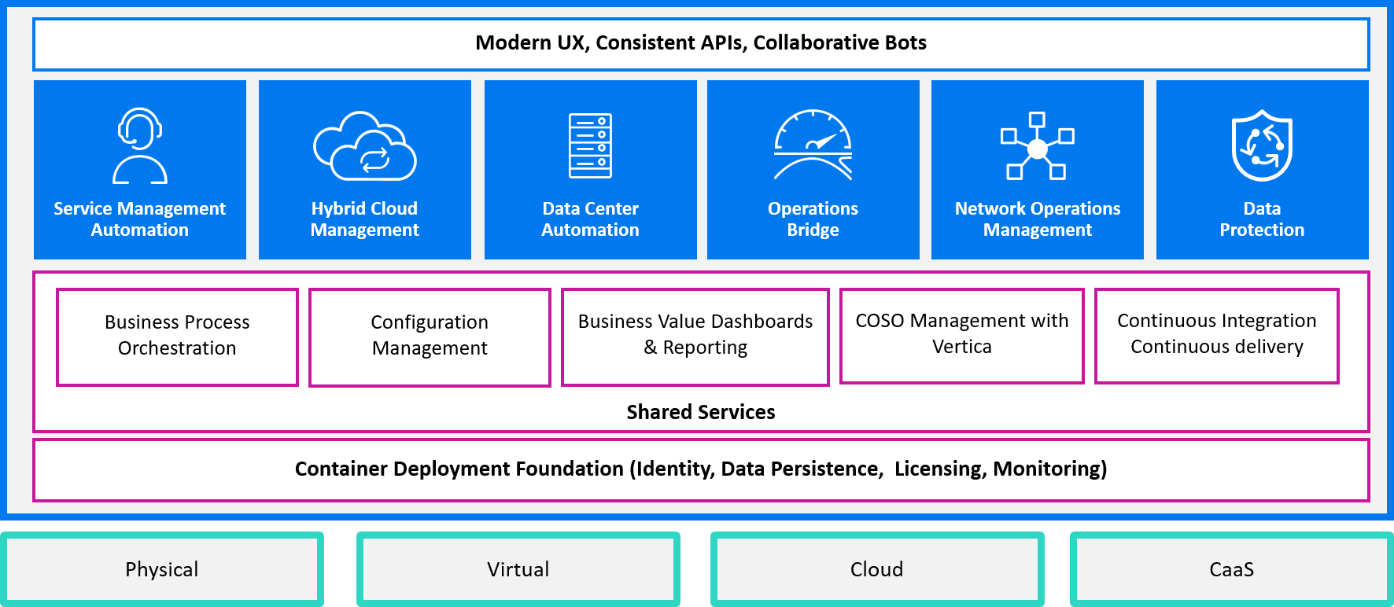
ITOM Platform
Message to: enterprise architecture team
Portable, Modern, Flexible
Shared services
Continuous delivery, seamless updates
Quarterly releases
Predictable, routine-like deployments and updates
SaaS-like experiences on prem (TTV, seamless)
Easier to consume smaller releases, but can skip
Seamless, rolling update (as of 2018.05)
In place based on system dependencies
Ensures minimum downtime for components
SMAX combines three key application areas into a single solution:
IT Service Management (ITSM) IT Asset Management (ITAM)
Enterprise Service Management (ESM)

Slide 21



Traps to set for our competitors
See the battle cards for more information
Hidden costs / TCO message is overstated
Missing many enterprise requirements
High cost, complexity, TCO and slow time to value
Old UI and platform is lacking machine learning and big data
Lack of ITOM maturity, integrations and big data platform
Lack of big data analytics
Limited deployment options – mostly SaaS
Weak CMS and CMDB
Portfolio overlaps, complex licensing
Notes:
Service-now traps to set:
Big Data Analytics are imperative per Gartner. Clarify that it is not the same as the Reporting analytics in Service-now. Our Big Data Analytics is a key differentiator against all of our competitors.
Have Service-now reference accounts been able to negotiate a renewal without major pricing changes? We hear that recent pricing changes have resulted in significant price increases or confusing to negotiate at renewal time.
No concurrent user licensing can make it more expensive. Also, how are self-service approvers licensed? We believe that self-service approvers do require licensing.

Slide 22
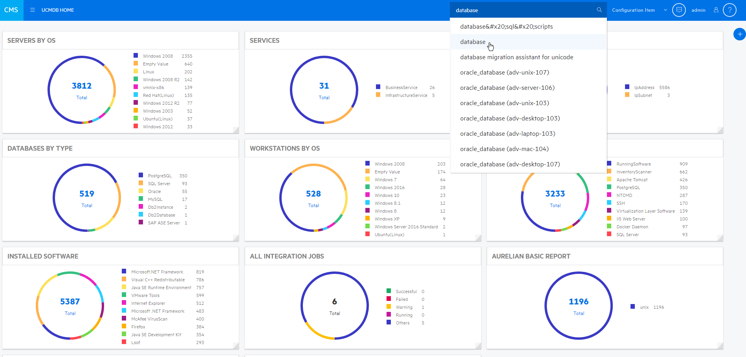
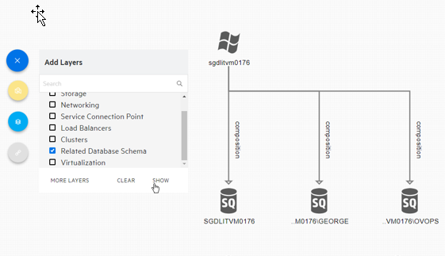
The Micro Focus CMS Advantage
The highest quality, real-time data supporting IT Ops
Breadth and depth of discovery: agent, agent-less or hybrid discovery in one tool Multi-cloud discovery of private and public cloud Automated service modeling for quick modeling of services Modern, intuitive UI Smart Software Analytics for proactive software license additions
Notes:
Superior discovery:
Versatile top-down and bottoms-up discovery offering agent-based, agent-less, hybrid and passive discovery in one tool providing maximum flexibility for any configuration goal of dependency or inventory mapping
Cloud-ready discovery: real-time event based discovery ensures environments are always up-to-date, discovery can exist in the cloud, and rich set of native public cloud discovery capabilities
Automated Service Modeling: Easy and fast service modeling using algorithms and application configuration files to top-down model a business service by just entering the URL of the service. High value as it is included with purchase of UD. This drastically reduces the time it takes to map services within an organization (a process that when done manually could take weeks or months)
Machine learning in discovery of software licenses and Oracle-verified license discovery provides high depth of detail of software characteristics on deployed systems and drastically reduces the amount of time spent by st
Modern UI: UCMDB Browser, UCMDB Home, and Probe dashboard greatly simplify CMS administration and onboarding of the product to new users

Slide 23
CMS Traps to set for ServiceNow ServiceWatch
See battle card and Competitive site for more information
Depth of discovery
Micro Focus has deeper discovery for network, Windows, Linux and cloud
Micro Focus CMS is verified by Oracle to support LMS audits
Agentless only
Micro Focus agent-based discovery has visibility to servers/workstations behind firewalls and VPNs
Scalability
UCMDB can store 150M CIs and Relationships in a single deployment
Vendor Lock-in
Many ServiceNow Service Desk customers are using Micro Focus CMS
Micro Focus CMS customers are not locked in to a single vendor: discovery can be leveraged across all major CMDBs
Cost
Micro Focus Universal Discovery is up to 200% cheaper than ServiceWatch discovery

Slide 24
Traps our competitors will set for Micro Focus
1
2
3
Gartner ITSSM MQ Placement
Perceived Cost & Complexity
Is Micro Focus a safe choice?
ServiceNow and BMC MQ leaders while Micro Focus is viewed as niche
Painful migrations
Multiple products
Difficult integrations
No SaaS solution
Declining market share
Investment questions
Micro Focus spin/merge
Gartner evaluation criteria is 10 years old – e.g. doesn’t capture Micro Focus Big Data capabilities.
Forrester has rated Micro Focus as a leader in their ESM Wave.
Peer review sites such as G2crowd, IT Central Station and even Gartner’s Peer Insight show Micro Focus positively
Codeless configuration simplifies initial config and upgrades
SMAX is our strategic direction
Containerization simplifies deployments
Flexible deployment options for on-premise, cloud, and partner Managed Service offerings
New, innovative capabilities with Big Data Analytics
Pure-play software company
Complete ITOM and ADM solutions
Notes:
SaaS vs Non-SaaS Shares
ServiceNow and BMC MQ Leaders while Micro Focus is viewed as niche
Gartner ITSSM Critical capability reports position Service Anywhere and Service Manager more positively
Peer review sites such as G2crowd, IT Central Station and even Gartner’s Peer Insight show Micro Focus positively
Gartner evaluation criteria is 10 years and does not capture Micro Focus Big Data capabilities and derived benefits/value
Download response document from the sales portal
2) Perceived Cost & Complexity (on-premise)
Process Designer dramatically simplifies initial configuration and migrations
SMA Premium suite reduces current multi-product complexity
SMA suite containerization will improve and simplify solution deployments, maintenance, and the SACM integration
3) Is Micro Focus a safe choice?
New, innovate capabilities (BigData, ChatOps & Service Portal) implemented on Service Manager
Micro Focus is the right choice for Micro Focus Software customers
Scale – with $4.5B in revenue the combined company will be one of the top 10 software companies
Focus – pure-play software company focused on building, selling, and supporting software solutions that bring long-term value to our customers
Continuity – complimentary portfolio of products

Slide 25
Strategies to Win
Lead with Big Data Analytics
Sell the power of the portfolio
Highlight lower Total Cost of Ownership/Time to Value
Big Data analytics and machine learning are unique Micro Focus capabilities that:
Enable end-users to be more self-sufficient reducing ticket volumes and improving satisfaction.
Enable service desk agents to handle tickets more quickly and efficiently
Provide actionable insight enabling proactive problem management and process improvement for change management
Micro Focus provides complete ITSM and Enterprise Management solutions
Start simply with built-in processes based on leading approaches, such as ITILv3 and IT4IT
Easily configure and maintain with Studio
Micro Focus is leading the IT Management industry in providing suites based on containers and micro services
Easier deployment and upgrades
Aligning with overall industry container computing and application delivery trends
Private and public cloud deployments or MSP service offerings

